Slide 1
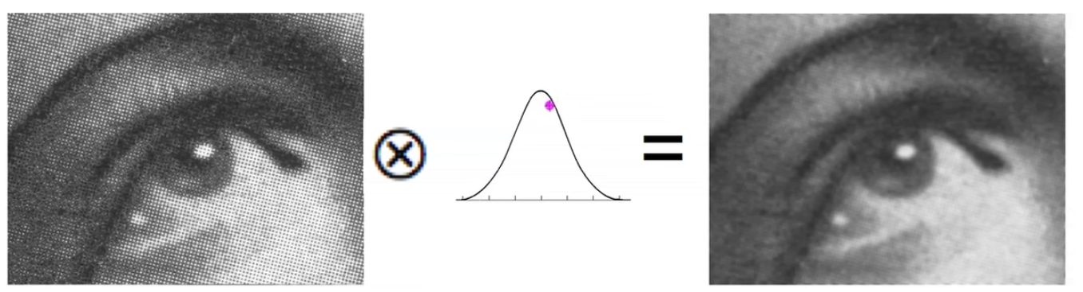
Semana #9

Slide 2

Clase #9 (25 Junio- 1 Julio) - Laboratorio: Enviar email con grupo de 2 personas para exposición con tres posibles temas a exponer. - Teoría: Review Parcial 1 - Teoría: Imagenes a color, padding, correlation & convolution - Laboratorio: Asignación tarea #8 Clase #10 (2 Julio- 8 Julio) - Laboratorio: Entrega Tarea #8 - Teoría: Cont. Filtros - Laboratorio: Asignación tarea #9 Clase #11 (8 Julio - 15 Julio) - Examen #2 Clase #12 (16 Julio - 22 Julio) - Laboratorio: Envío Tarea #9 - Review Examen #2 – 25 Minutos - Exposición Final (Grupo 1, 2, 3 & 4) -- 25 Minutos por Grupo - Laboratorio: Asignación tarea #10 Clase #13 (23 Julio - 28 Julio) - Exposición Final (Grupo 5, 6, 7, 8 & 9) -- 25 Minutos por Grupo - Laboratorio: Entrega Tarea #10

Slide 3
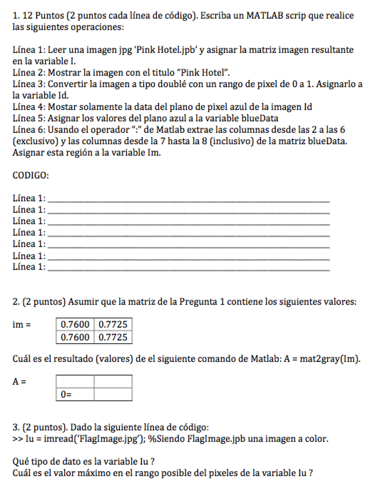

Slide 4
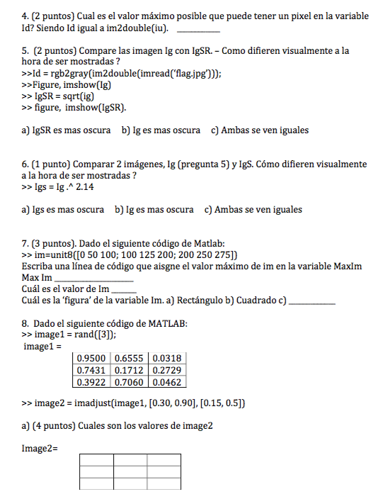

Slide 5
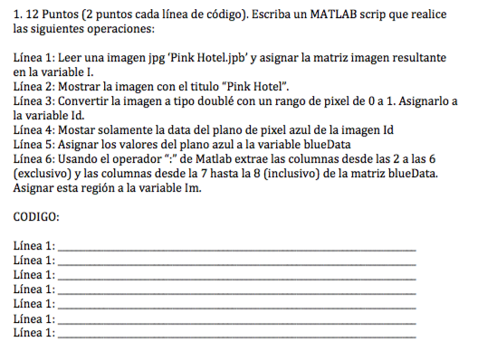

Slide 6
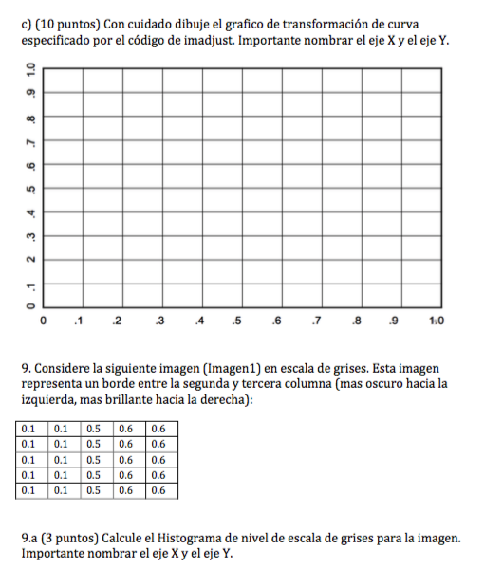

Slide 7
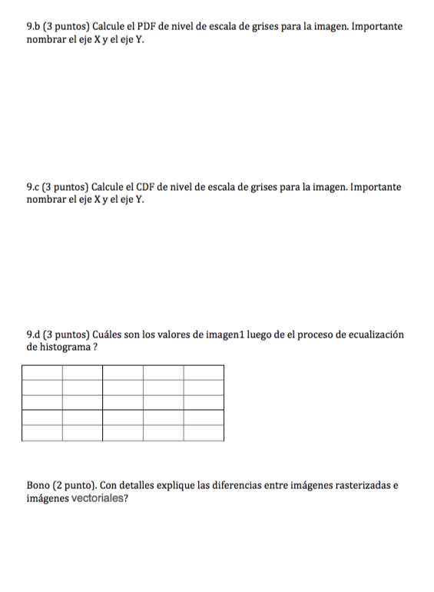

Slide 8
A few remarks concerning color images

Slide 9
Create a ‘color image’
First create three color planes of data
>> red = rand(5)
red =
0.0294 0.0193 0.3662 0.7202 0.0302
0.7845 0.3955 0.2206 0.4711 0.2949
0.7529 0.1159 0.6078 0.9778 0.5959
0.1586 0.1674 0.5524 0.9295 0.1066
0.7643 0.6908 0.3261 0.5889 0.1359
>> green = rand(5)
green =
0.2269 0.5605 0.6191 0.0493 0.1666
0.0706 0.4051 0.3297 0.7513 0.6484
0.9421 0.0034 0.8243 0.7023 0.8097
0.8079 0.5757 0.6696 0.9658 0.8976
0.0143 0.3176 0.6564 0.1361 0.0754
>> blue = rand(5)
blue =
0.6518 0.0803 0.8697 0.6260 0.9642
0.5554 0.2037 0.8774 0.5705 0.6043
0.8113 0.8481 0.5199 0.0962 0.8689
0.5952 0.2817 0.6278 0.7716 0.8588
0.5810 0.9290 0.2000 0.1248 0.7606

Slide 10
colorIm(:,:,1) =
0.0294 0.0193 0.3662 0.7202 0.0302
0.7845 0.3955 0.2206 0.4711 0.2949
0.7529 0.1159 0.6078 0.9778 0.5959
0.1586 0.1674 0.5524 0.9295 0.1066
0.7643 0.6908 0.3261 0.5889 0.1359
colorIm(:,:,2) =
0.2269 0.5605 0.6191 0.0493 0.1666
0.0706 0.4051 0.3297 0.7513 0.6484
0.9421 0.0034 0.8243 0.7023 0.8097
0.8079 0.5757 0.6696 0.9658 0.8976
0.0143 0.3176 0.6564 0.1361 0.0754
colorIm(:,:,3) =
0.6518 0.0803 0.8697 0.6260 0.9642
0.5554 0.2037 0.8774 0.5705 0.6043
0.8113 0.8481 0.5199 0.0962 0.8689
0.5952 0.2817 0.6278 0.7716 0.8588
0.5810 0.9290 0.2000 0.1248 0.7606
>> colorIm(:,:,1)=red;
>> colorIm(:,:,2)=green;
>> colorIm(:,:,3)=blue;
>> colorIm
figure
imshow(colorIm, 'InitialMagnification', 'fit')

Slide 11
colorIm
colorIm(1,1,: )
colorIm(4,4,: )

Slide 12
colorIm(:,:,1) =
0.0294 0.0193 0.3662 0.7202 0.0302
0.7845 0.3955 0.2206 0.4711 0.2949
0.7529 0.1159 0.6078 0.9778 0.5959
0.1586 0.1674 0.5524 0.9295 0.1066
0.7643 0.6908 0.3261 0.5889 0.1359
colorIm(:,:,2) =
0.2269 0.5605 0.6191 0.0493 0.1666
0.0706 0.4051 0.3297 0.7513 0.6484
0.9421 0.0034 0.8243 0.7023 0.8097
0.8079 0.5757 0.6696 0.9658 0.8976
0.0143 0.3176 0.6564 0.1361 0.0754
colorIm(:,:,3) =
0.6518 0.0803 0.8697 0.6260 0.9642
0.5554 0.2037 0.8774 0.5705 0.6043
0.8113 0.8481 0.5199 0.0962 0.8689
0.5952 0.2817 0.6278 0.7716 0.8588
0.5810 0.9290 0.2000 0.1248 0.7606

Slide 13
What are two methods to convert from a color image to a gray scale image?

Slide 14
RECALL
What are two methods to convert from a color image to a gray scale image?
Average red, green and blue pixels

Slide 15
Average
For example:
>> colorImAverage = ( colorIm(:,:,1) + colorIm(:,:,2) + colorIm(:,:,3) )/3
colorImAverage =
0.3027 0.2200 0.6183 0.4651 0.3870
0.4701 0.3348 0.4759 0.5976 0.5159
0.8354 0.3224 0.6507 0.5921 0.7582
0.5206 0.3416 0.6166 0.8890 0.6210
0.4532 0.6458 0.3942 0.2833 0.3240
>> figure, imshow(colorImAverage, 'InitialMagnification', 'fit')

Slide 16
Gray scale version of color image
.5976
.5921

Slide 17
Color and Gray scale Images

Slide 18
Color and Gray scale Images
Conversion to gray scale results in a loss of information

Slide 19
What are two methods to convert from a color image to a gray scale image?
Average red, green and blue pixels
Matlab’s rgb2gray function

Slide 20
MATLAB’s rgb2gray Function
>> colorIm_rgb2gray = rgb2gray(colorIm)
colorIm_rgb2gray =
0.2163 0.3439 0.5721 0.3156 0.2168
0.3393 0.3792 0.3596 0.6469 0.5377
0.8706 0.1333 0.7249 0.7155 0.7525
0.5895 0.4202 0.6298 0.9328 0.6567
0.3031 0.4989 0.5056 0.2702 0.1716

Slide 21
colorIm and rgb2gray(colorIm)

Slide 22
How does rgb2gray work?
rgb2gray converts RGB values to grayscale values by forming a weighted sum of the R, G, and B components:
Gray = 0.2989 * R + 0.5870 * G + 0.1140 * B
https://www.mathworks.com/help/images/ref/rgb2ntsc.html

Slide 23
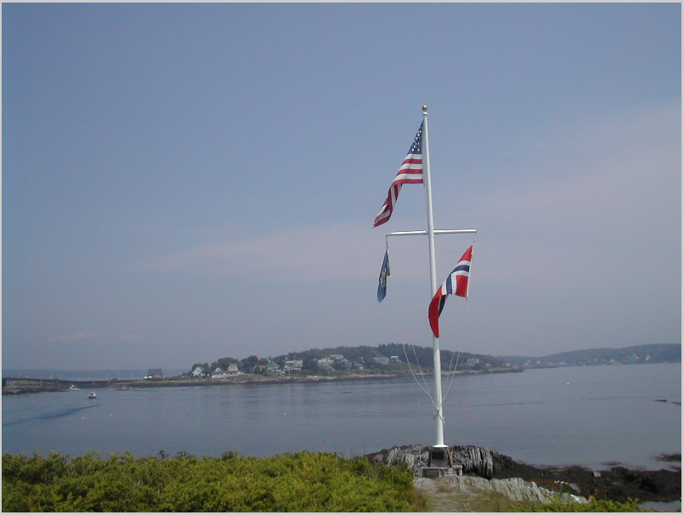
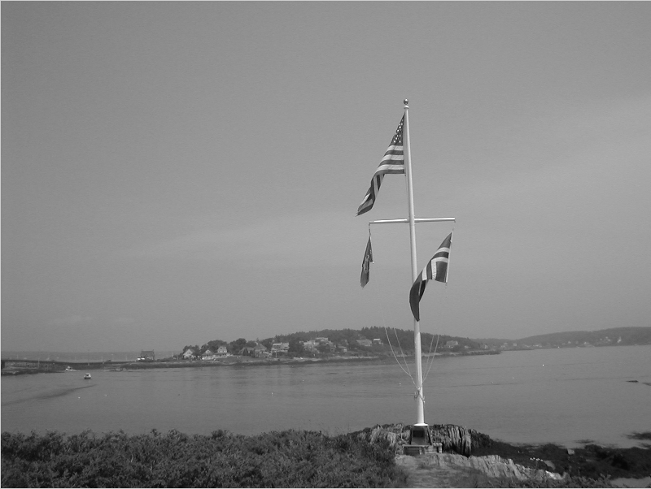
Color and Gray Scale Images

Slide 24
PADDING

Slide 25
Padding -- padarray
fp = padarray(f, [r c], method, direction)
f is input image
fp is padded image
[r c] is number of rows and columns to pad f
method and direction – next slide

Slide 26
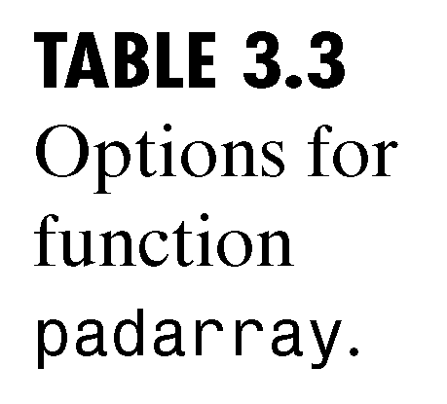
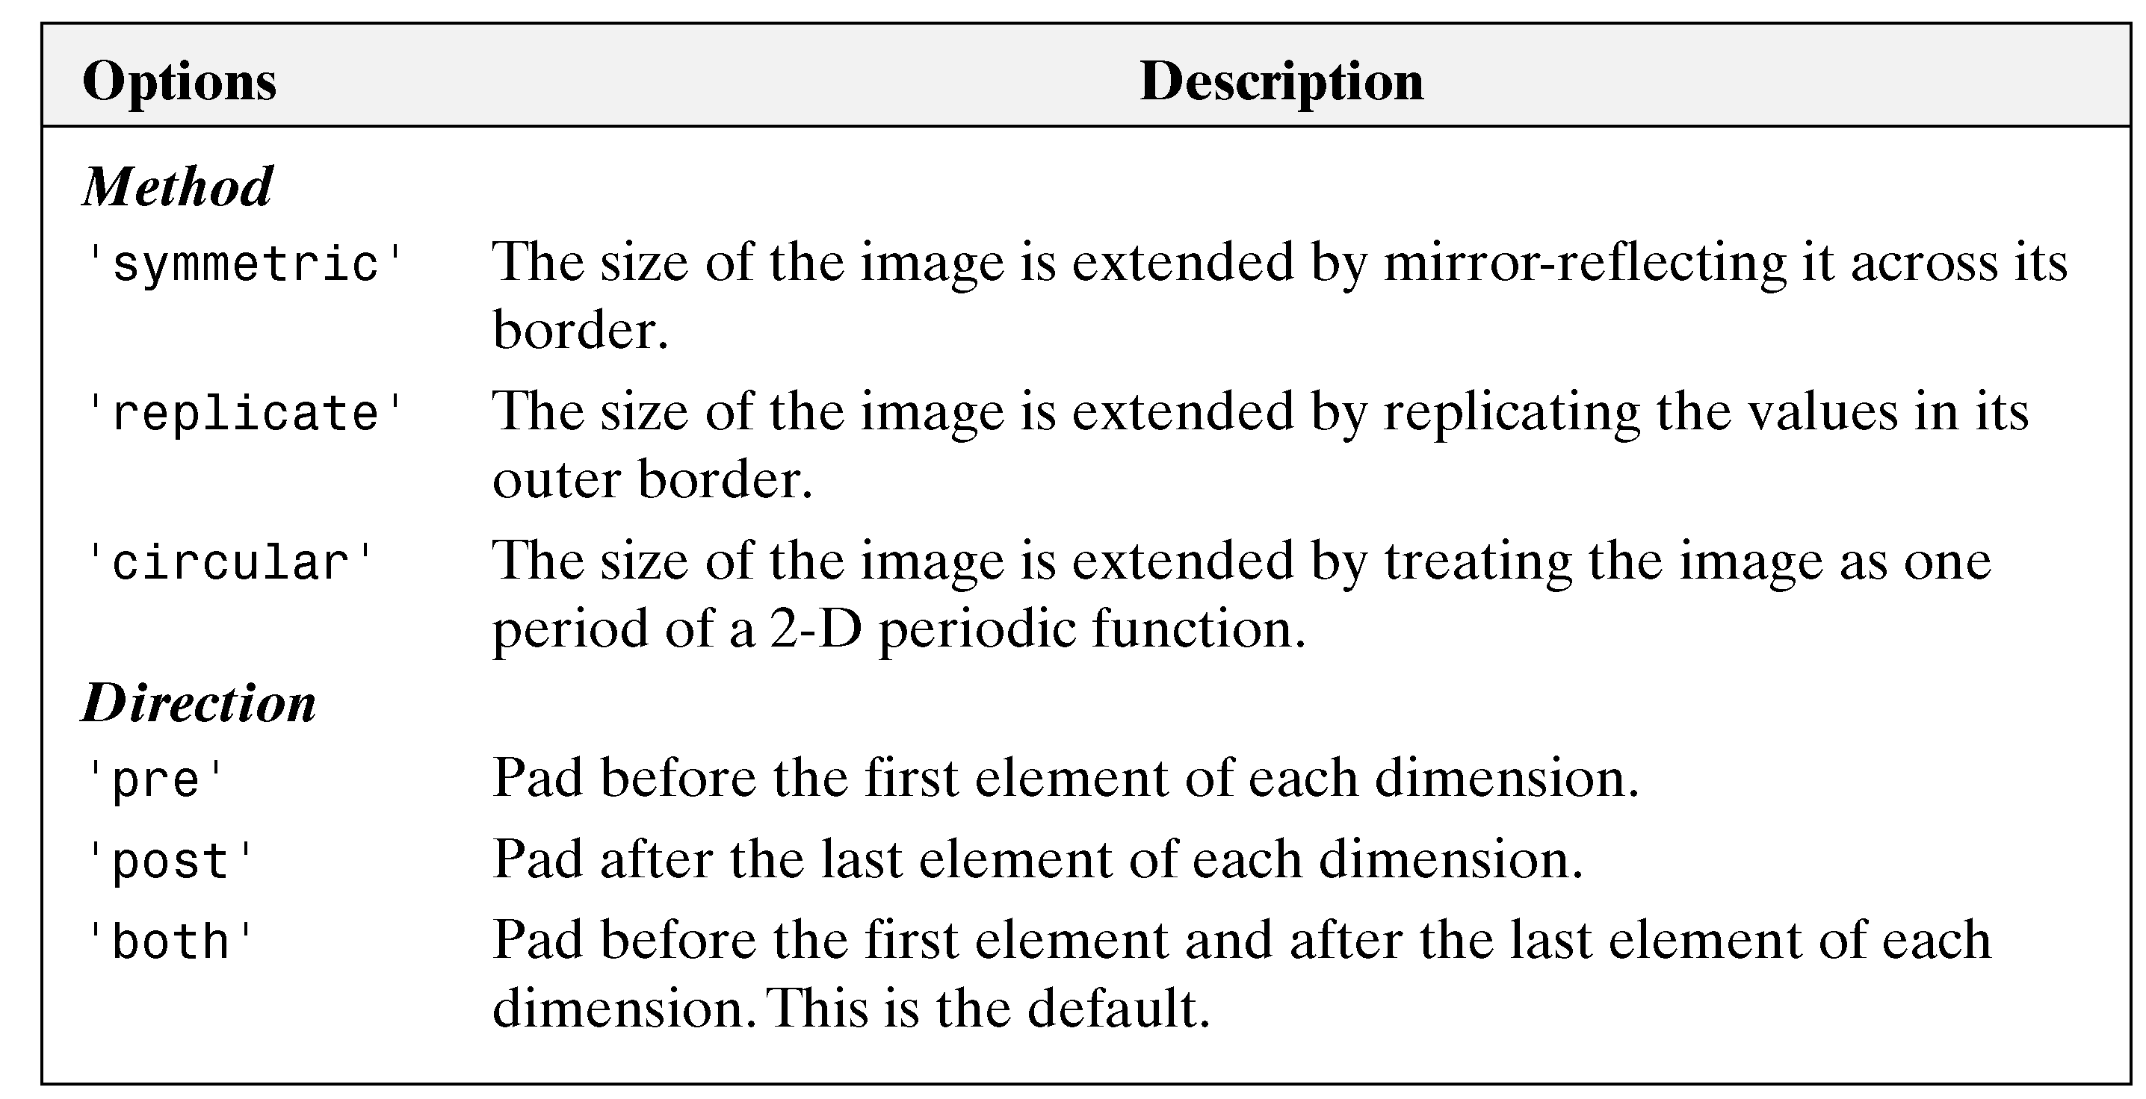
Chapter 3
www.prenhall.com/gonzalezwoodseddins

Slide 27
padarray Example
>> f = [1 2; 3 4]
f =
1 2
3 4
>> fp = padarray(f, [3 2], 'replicate', 'post')
fp =
1 2 2 2
3 4 4 4
3 4 4 4
3 4 4 4
3 4 4 4
Post – pad after the last element in both directions
[3 2] – pad 3 rows and 2 columns

Slide 28
>> fp = padarray(f, [2 1], 'replicate', 'post')
fp =
1 2 2
3 4 4
3 4 4
3 4 4
Post – pad after the last element in both directions
[2 1] – pad 2 rows and 1 columns

Slide 29
>> f = [1 2 3; 1 2 3; 1 2 3]
f =
1 2 3
1 2 3
1 2 3
>> fp = padarray(f, [2 2], 'symmetric', 'both')
fp = ??????

Slide 30
>> f = [1 2 3; 1 2 3; 1 2 3]
f = 1 2 3
1 2 3
1 2 3
>> fp = padarray(f, [2 2], 'symmetric', 'both')
fp =
2 1 1 2 3 3 2
2 1 1 2 3 3 2
2 1 1 2 3 3 2
2 1 1 2 3 3 2
2 1 1 2 3 3 2
2 1 1 2 3 3 2
2 1 1 2 3 3 2

Slide 31
FILTERING

Slide 32
Spatial Filtering
Neighborhood processing
Define center point (x, y)
Perform operations involving only pixels in the neighborhood
Result of operation is response to process at that point
Moving the pixel results in a new neighborhood
Repeat process for every point in the image

Slide 33
Linear and Nonlinear Spatial Filtering
Linear operation
Multiply each pixel in the neighborhood by the corresponding coefficient and sum the results to get the response for each point (x, y)
If neighborhood is m x n , then mn coefficients are required
Coefficients are arranged in a matrix, called
filter / filter mask / kernel / template
Mask sizes are typically odd numbers (3x3, 5x5, etc.)

Slide 34
w (-1, -1) | w (-1, 0) | w(-1, 1)
w (0, -1) | w (0, 0) | w(0, 1)
w(1, -1) | w (1, 0) | w(1, 1)
Image origin
y
Kernel coefficients
mask
f (x-1, y-1) | f (x-1, y) | f (x-1, y+1)
f (x, y-1) | f (x, y) | f (x, y+1)
f (x+1, y-1) | f (x+1, y) | f (x+1, y+1)
x
Image region under mask

Slide 35
Correlation and Convolution

Slide 36
Correlation and Convolution
Correlation
Place mask w on the image array f as previously described
Convolution
First rotate mask w by 180 degrees
Place rotated mask on image as described previously
Convolution = 180 degree rotation + correlation

Slide 37
Example: 1D Correlation
Assume w and f are one dimensional
Origin of f is its left most point
Place w so that its right most point coincides with the origin of f
Pad f with 0s so that there are corresponding f points for each w point (also pad end with 0s)
Multiply corresponding points and sum
In this case (example on next page) result is 0
Move w to the right one value, repeat process
Continue process for whole length of f

Slide 38
Reminder
‘full’ is the result we obtain from the operations on the previous slide. If instead of aligning the left most element of f with the right most element of w we aligned the center element of w with the left most value of f we would obtain the ‘same’ result, same indicating the result is the same length of the original w

Slide 39
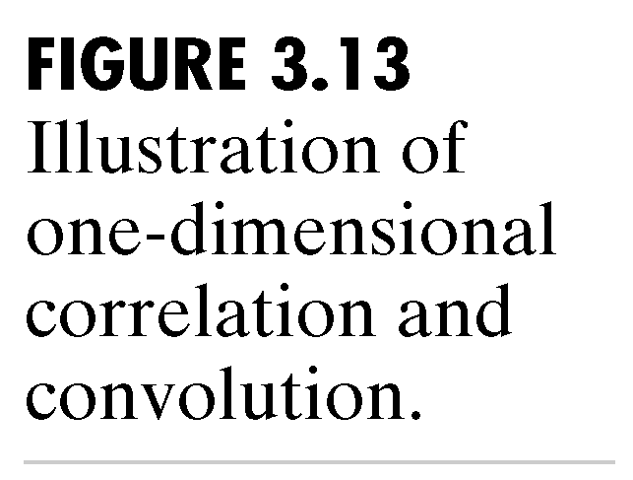
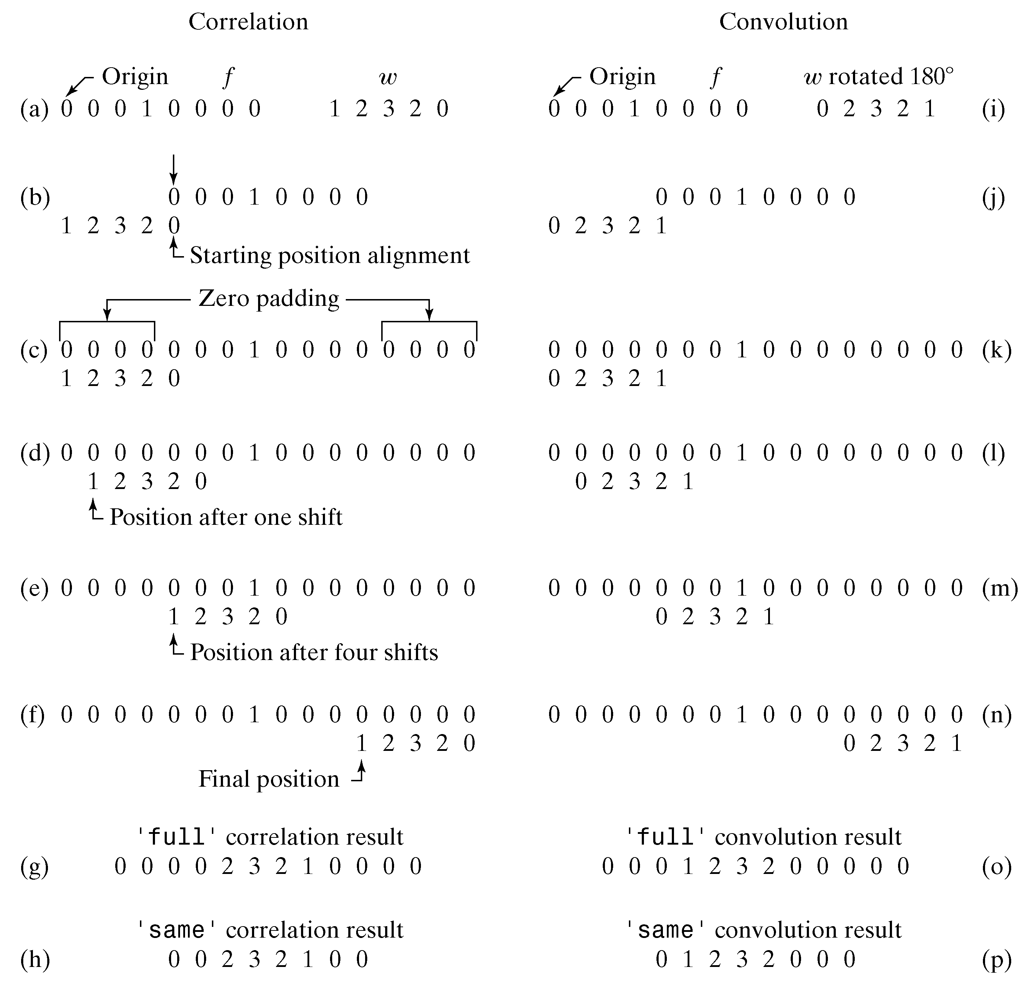
Chapter 3
www.prenhall.com/gonzalezwoodseddins

